Slide 1
Discussion questions
In relation to the R exercise
How many species of butterfly are there? How do you weigh the different lines of evidence? What caveats limit the inferences you can make? How could you address them?
Taking a broader view, do you think we tend to underestimate or overestimate biodiversity?
How does the Drosophila mating experiment inform our understanding of speciation? Can you explain why the pattern of the evolution of premating isolation differs for allopatric and sympatric species pairs? What does it mean for the importance of reinforcement?
How and why might evolution in different environments impact reproductive isolation? As fly lines evolved in different environments, what do you think happened? Can you speculate how that may have impacted reproductive isolation?
Before you get started:
Make sure to introduce each other
Choose a timekeeper
Choose a reporter
Breakout groups for 20 minutes

Slide 2
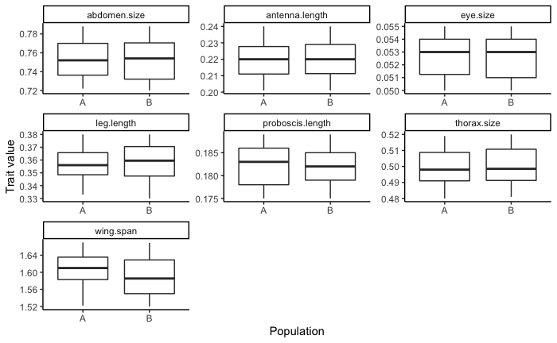
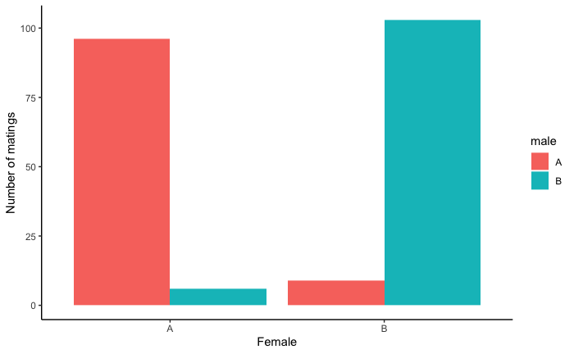
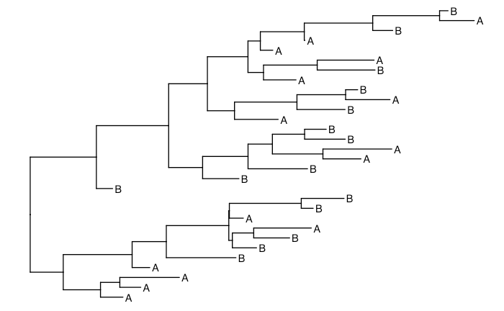
How many species?
Morphology
How did you weigh different lines of evidence?
Behavior
Phylogeny

Slide 3
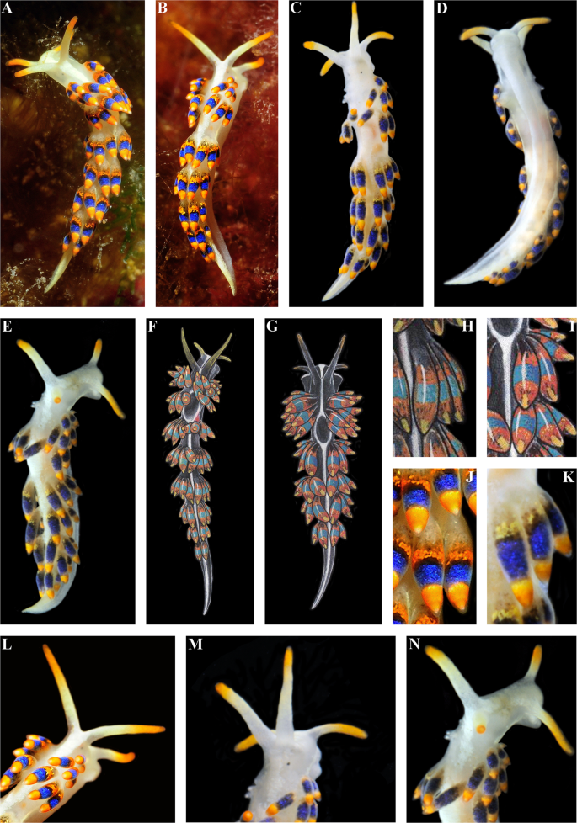
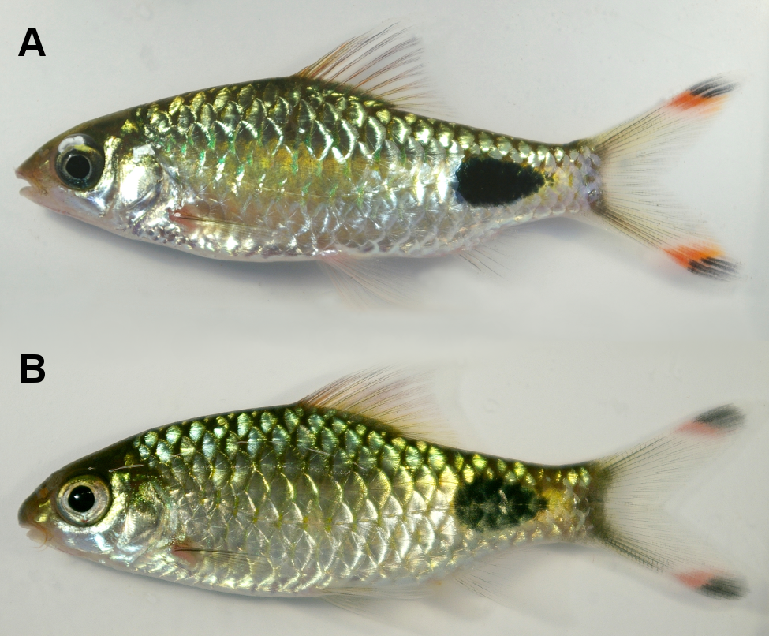
How many species?
Cryptic species are common…

Slide 4
How many species?
Cryptic species are common…
… so are false descriptions!
Phenotypic plasticity in the gaudy commodore
Plestiodon obsoletus
Lamprosaurus guttulatus

Slide 5

How many species?
Cryptic species are common…
… so are false descriptions!
Mirapinnidae
Megalommycteridae
Cetomimidae

Slide 6
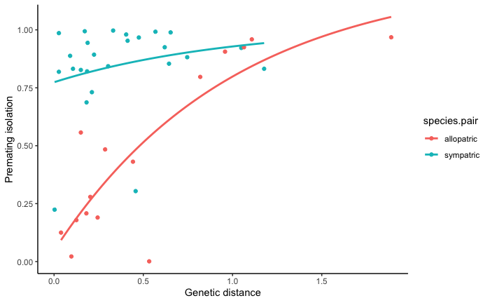
Evolution of pre-mating isolation
How does this inform our understanding of speciation?
What does this mean for the importance of reinforcement?

Slide 7
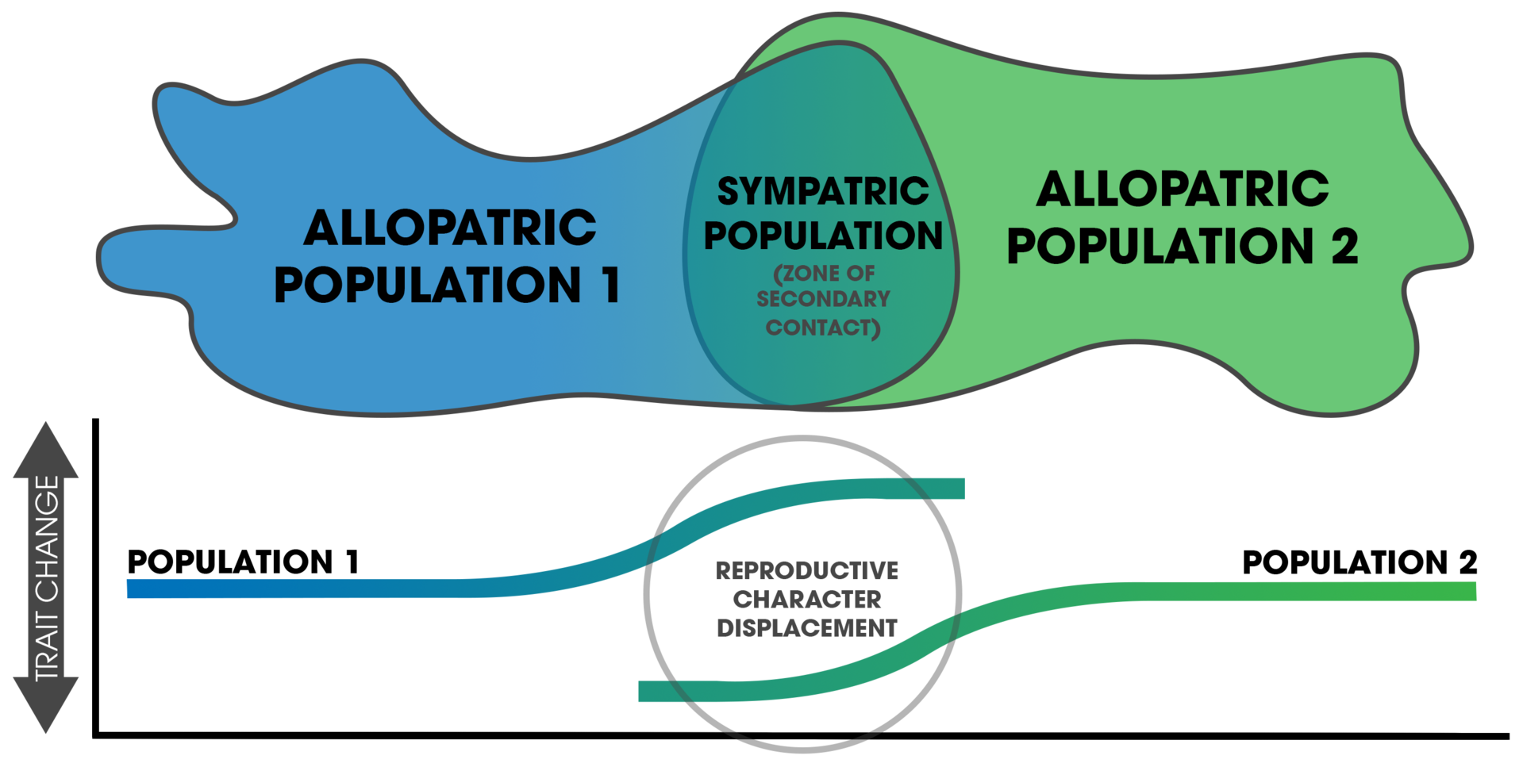
Evolution of pre-mating isolation
Allopatric speciation takes a long time to complete, and reproductive isolation is almost impossible to quantify

Slide 8
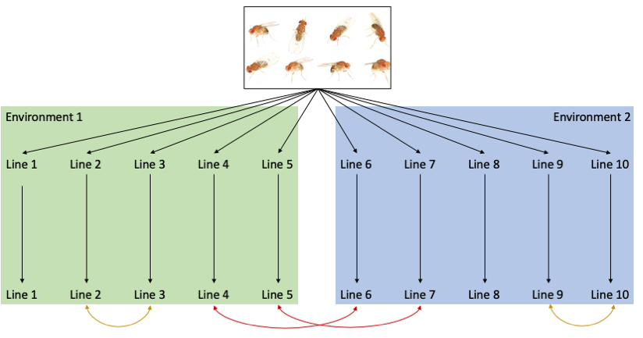
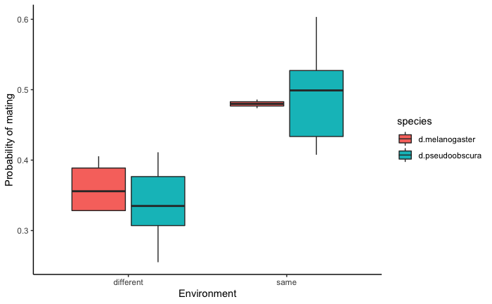
Experimental evolution and reproductive isolation
How and why might evolution in different environments impact reproductive isolation?

Slide 9
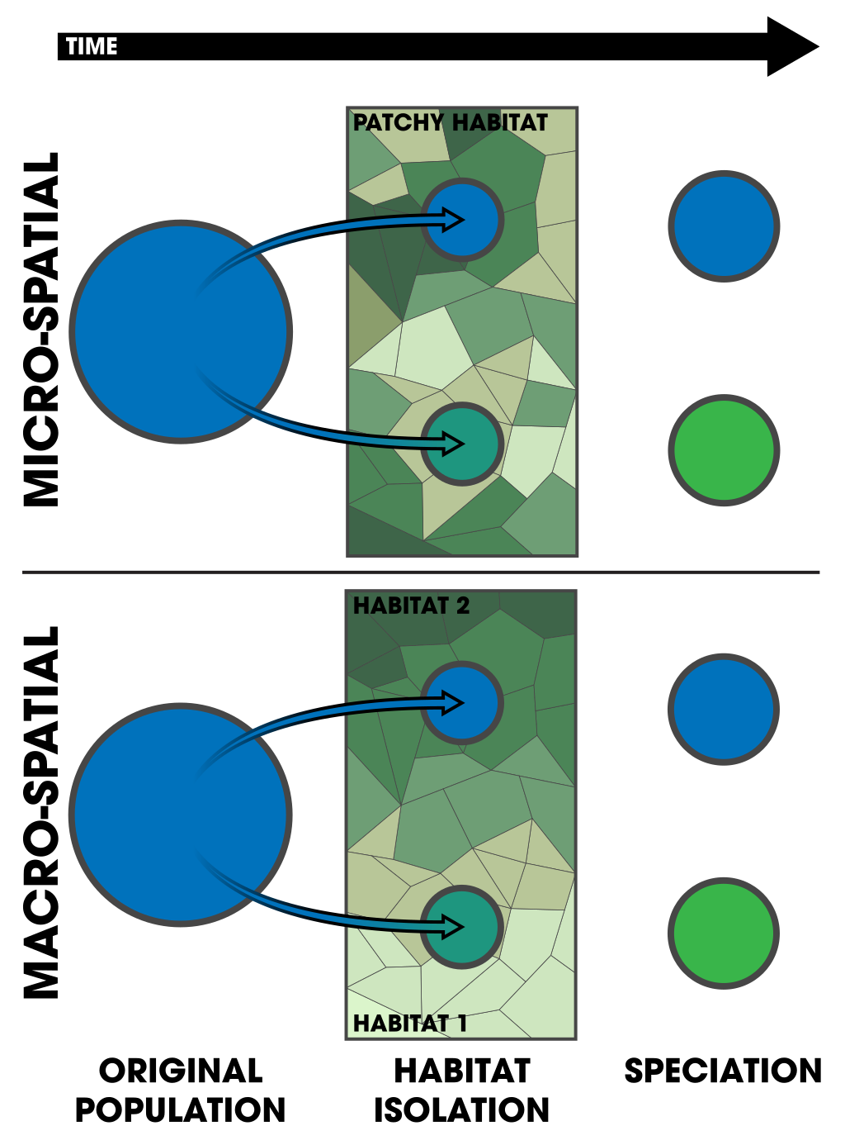
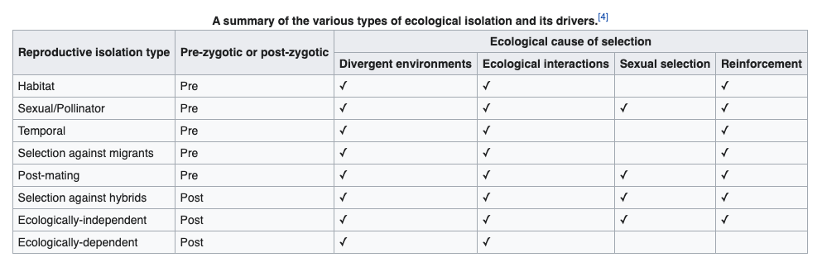
Experimental evolution and reproductive isolation
Evolution in different environments can inadvertently lead to reproductive isolation
Virtually any mechanism can be involved
Virtually any spatial arrangement can be involved

Slide 10
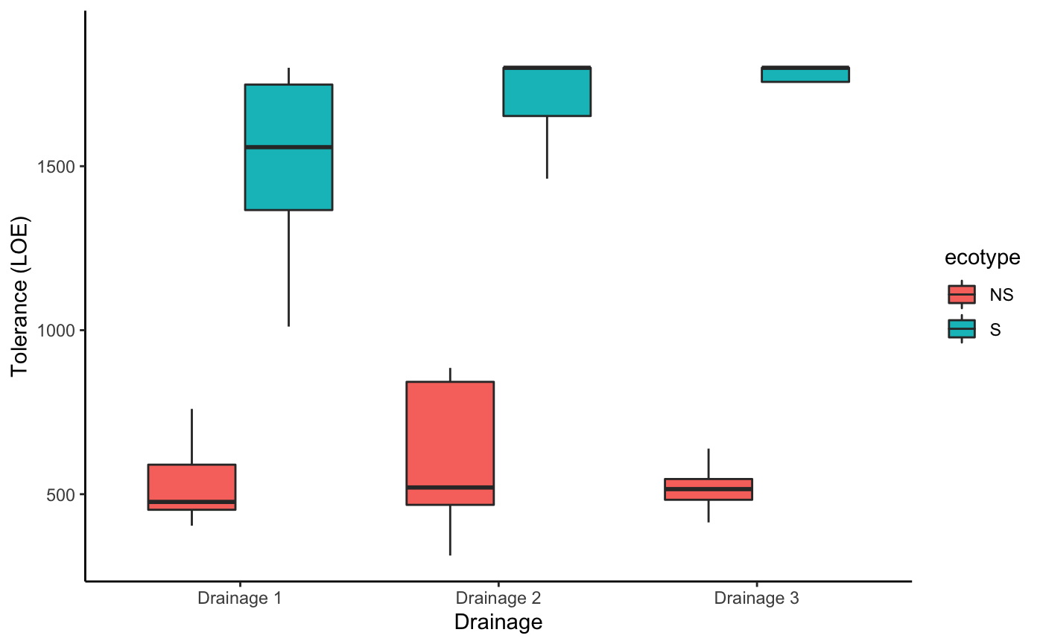
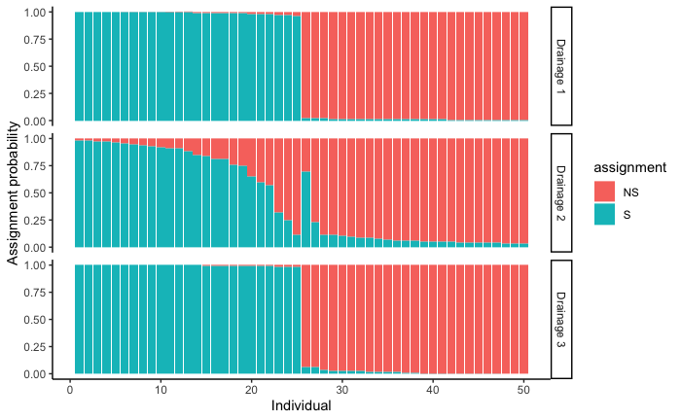
Evolution in extreme environments
Is it adaptation or are these fish just naturally tolerant?

Slide 11
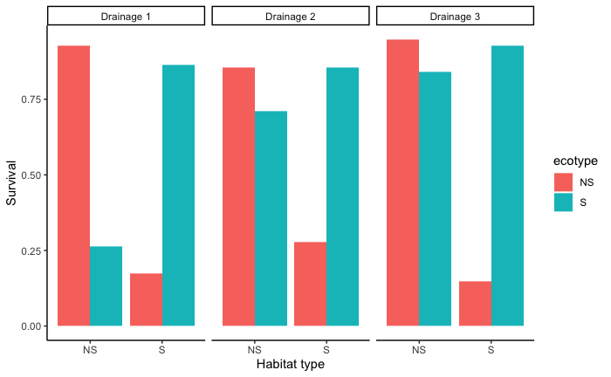
Evolution in extreme environments
What mechanisms mediate reproductive isolation?

